Slide 1

Introdução à Computação Banco de Dados 60 hrs
Prof MSc Wellington
Jose.wellington@ceub.edu.br
‹#›

Slide 2
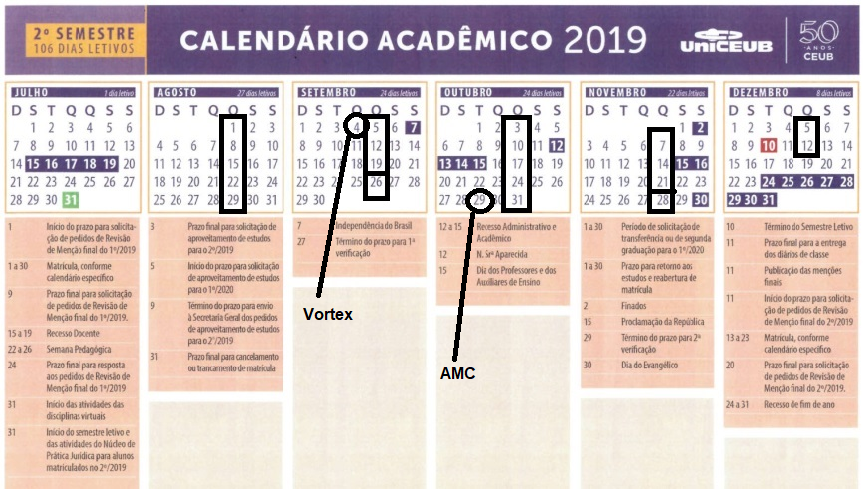
Plano de Ensino
‹#›
Notes:
‹#›
Large enterprise applications - the ones that execute core business applications, and keep a company going - must be more than just a bunch of code modules. They must be structured in a way that enables scalability, security, and robust execution under stressful conditions, and their structure - frequently referred to as their architecture - must be defined clearly enough that maintenance programmers can (quickly!) find and fix a bug that shows up long after the original authors have moved on to other projects. That is, these programs must be designed to work perfectly in many areas, and business functionality is not the only one (although it certainly is the essential core). Of course a well-designed architecture benefits any program, and not just the largest ones as we've singled out here. We mentioned large applications first because structure is a way of dealing with complexity, so the benefits of structure (and of modeling and design, as we'll demonstrate) compound as application size grows large. Another benefit of structure is that it enables code reuse: Design time is the easiest time to structure an application as a collection of self-contained modules or components. Eventually, enterprises build up a library of models of components, each one representing an implementation stored in a library of code modules. When another application needs the same functionality, the designer can quickly import its module from the library. At coding time, the developer can just as quickly import the code module into the application.

Slide 3
Objetivo
Conceitos Básicos
Banco de Dados
Banco de Dados – Vantagens
S.G.B.D. (Sistema Gerenciador de Banco de Dados)
Representação Física do SGBD
SQL - Structured Query Language, ou Linguagem de Consulta Estruturada
SGBD – Regras
Administradores de Banco de Dados (DBA)
Questionário
‹#›

Slide 4
Conceitos Básicos
Notes:
Large enterprise applications - the ones that execute core business applications, and keep a company going - must be more than just a bunch of code modules. They must be structured in a way that enables scalability, security, and robust execution under stressful conditions, and their structure - frequently referred to as their architecture - must be defined clearly enough that maintenance programmers can (quickly!) find and fix a bug that shows up long after the original authors have moved on to other projects. That is, these programs must be designed to work perfectly in many areas, and business functionality is not the only one (although it certainly is the essential core). Of course a well-designed architecture benefits any program, and not just the largest ones as we've singled out here. We mentioned large applications first because structure is a way of dealing with complexity, so the benefits of structure (and of modeling and design, as we'll demonstrate) compound as application size grows large. Another benefit of structure is that it enables code reuse: Design time is the easiest time to structure an application as a collection of self-contained modules or components. Eventually, enterprises build up a library of models of components, each one representing an implementation stored in a library of code modules. When another application needs the same functionality, the designer can quickly import its module from the library. At coding time, the developer can just as quickly import the code module into the application.

Slide 5
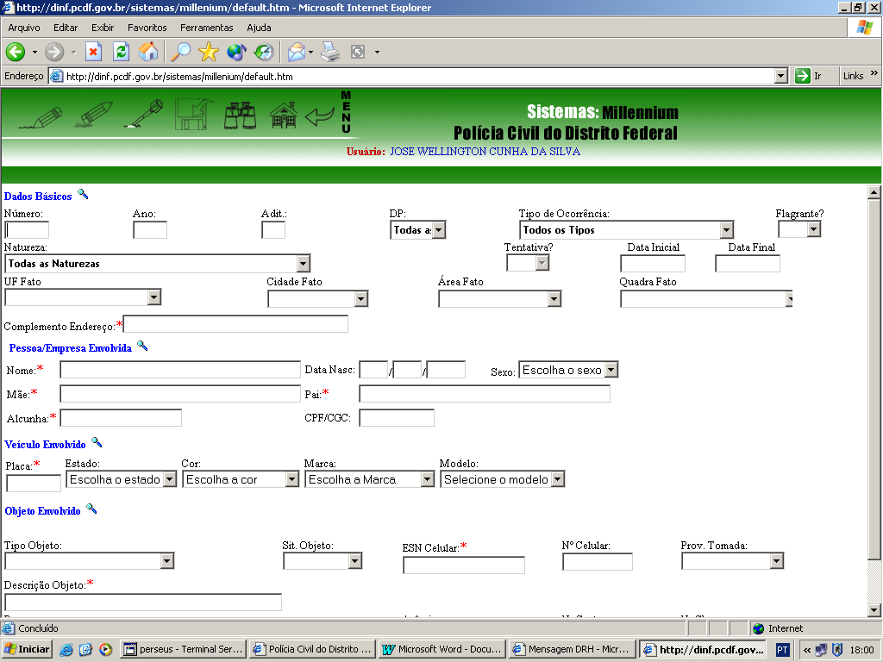
Dados
Dados incluem os itens que representam fatos, textos, gráficos, imagens estáticas, sons, segmentos de vídeo analógicos ou digitais etc.

Slide 6
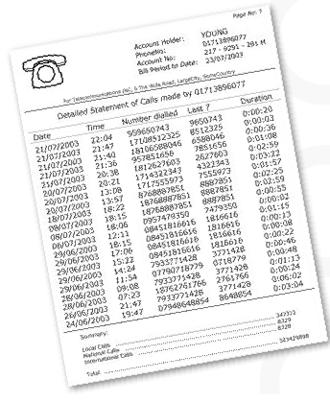
Informação
O processo de transformação envolve a aplicação de procedimentos, que incluem formatação, tradução, fusão, impressão e assim por diante.
A maior parte deste processo pode ser executada automaticamente

Slide 7
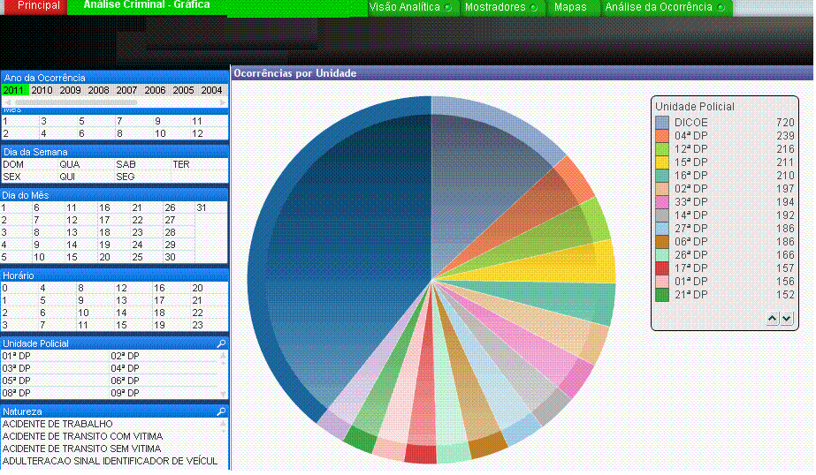
Conhecimento
É obtido pela interpretação e integração de vários dados e informações.
O processo de transformação é realizado por meio de avaliação de dados e informações.

Slide 8

Inteligência
Busca identificar tendências do mercado, desenvolver análises estratégicas, descobrir oportunidades e mapear riscos através de metodologias científicas.
- A Inteligência é o processo contínuo de monitoramento e análise estratégica dos cenários e conjunturas mercadológicas em que determinada empresa está inserida.

Slide 9
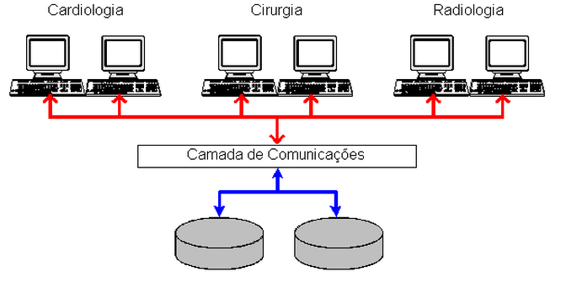
Dados Operacionais - Dados Persistentes
Qualquer empresa tem necessariamente de manter uma quantidade de dados sobre suas operações.
São os dados em um banco de dados com persistentes (por persistir muito tempo no banco de dados).
Dados sobre produtos, contabilidade, paciente e estudante.

Slide 10

Sistemas de Informação
É a expressão utilizada para descrever um sistema automatizado ou manual, que envolve pessoas, máquinas, e métodos para organizar, coletar, processar e distribuir dados para os usuários do sistema envolvido.
Um Sistema de Informação poder ser usado então para prover informação, qualquer que seja o uso feito dessa informação.

Slide 11
Banco de Dados
Notes:
Large enterprise applications - the ones that execute core business applications, and keep a company going - must be more than just a bunch of code modules. They must be structured in a way that enables scalability, security, and robust execution under stressful conditions, and their structure - frequently referred to as their architecture - must be defined clearly enough that maintenance programmers can (quickly!) find and fix a bug that shows up long after the original authors have moved on to other projects. That is, these programs must be designed to work perfectly in many areas, and business functionality is not the only one (although it certainly is the essential core). Of course a well-designed architecture benefits any program, and not just the largest ones as we've singled out here. We mentioned large applications first because structure is a way of dealing with complexity, so the benefits of structure (and of modeling and design, as we'll demonstrate) compound as application size grows large. Another benefit of structure is that it enables code reuse: Design time is the easiest time to structure an application as a collection of self-contained modules or components. Eventually, enterprises build up a library of models of components, each one representing an implementation stored in a library of code modules. When another application needs the same functionality, the designer can quickly import its module from the library. At coding time, the developer can just as quickly import the code module into the application.

Slide 12
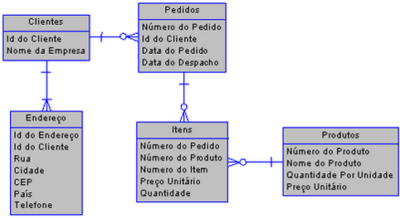
Banco de Dados
Coleção de Dados Relacionados

Slide 13

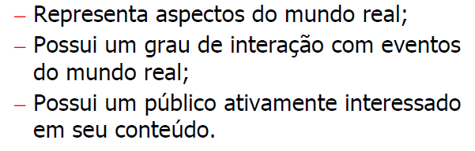

Banco de Dados – Propriedades Intrincicas

Slide 14
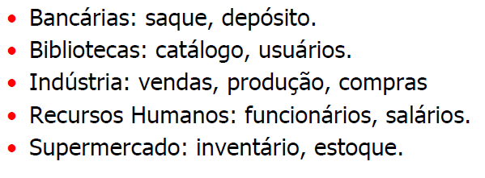
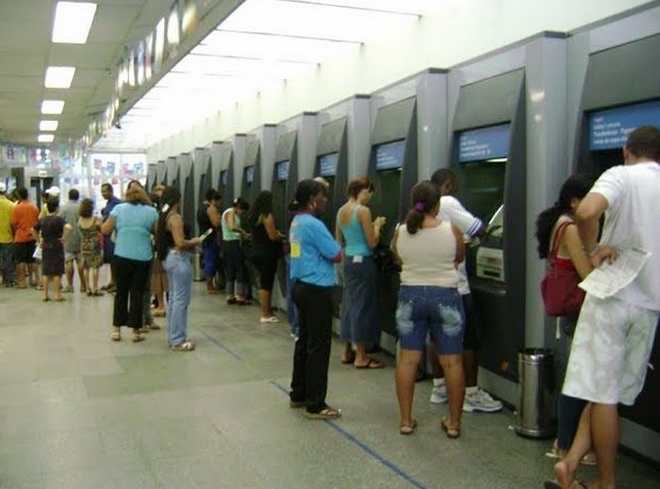
Banco de Dados - Aplicações

Slide 15
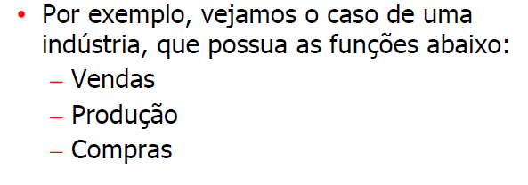
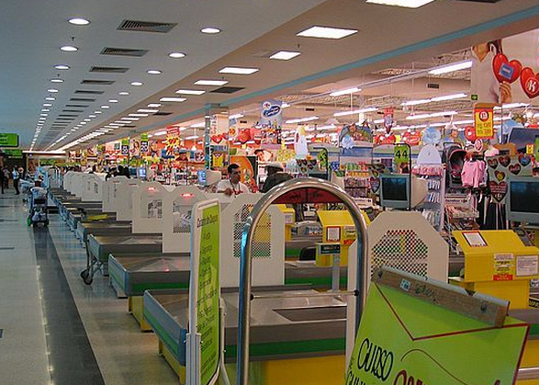
Implementação da Informática

Slide 16


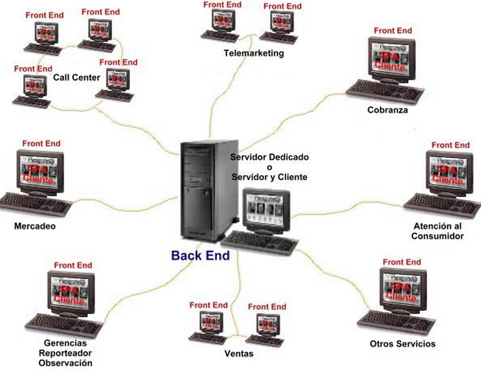
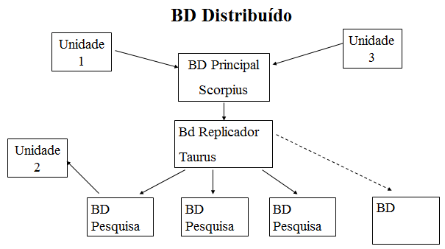

Slide 17
Banco de Dados - Vantagens
Notes:
Large enterprise applications - the ones that execute core business applications, and keep a company going - must be more than just a bunch of code modules. They must be structured in a way that enables scalability, security, and robust execution under stressful conditions, and their structure - frequently referred to as their architecture - must be defined clearly enough that maintenance programmers can (quickly!) find and fix a bug that shows up long after the original authors have moved on to other projects. That is, these programs must be designed to work perfectly in many areas, and business functionality is not the only one (although it certainly is the essential core). Of course a well-designed architecture benefits any program, and not just the largest ones as we've singled out here. We mentioned large applications first because structure is a way of dealing with complexity, so the benefits of structure (and of modeling and design, as we'll demonstrate) compound as application size grows large. Another benefit of structure is that it enables code reuse: Design time is the easiest time to structure an application as a collection of self-contained modules or components. Eventually, enterprises build up a library of models of components, each one representing an implementation stored in a library of code modules. When another application needs the same functionality, the designer can quickly import its module from the library. At coding time, the developer can just as quickly import the code module into the application.

Slide 18
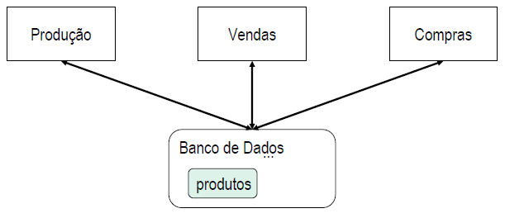
Banco de Dados – Vantagens
1-7 - Redução ou Eliminação de Redundâncias
- Possibilita a eliminação de dados privativos de cada sistema.
-Os dados, que eventualmente são comuns a mais de um sistema, são compartilhados por eles, permitindo o acesso a uma única informação sendo consultada por vários sistemas.

Slide 19
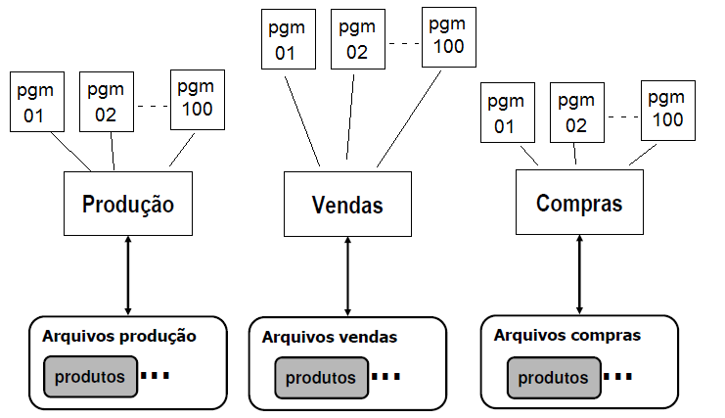
Sistema Isolados
Dados não Compartilha dados

Slide 20

Sistema Isolados - Redundância de dados
Dados não Compartilha dados
Um mesmo dado ocorre múltiplas vezes em locais diferenciados em um sistema computacional.
Inconsistência de dados.

Slide 21

Banco de Dados – Vantagens
2-7 - Eliminação de Inconsistências
- Através do armazenamento da informação em um único local com acesso descentralizado e, sendo compartilhada à vários sistemas, os usuários estarão utilizando uma informação confiável.
- A inconsistência ocorre quando um mesmo campo tem valores diferentes em sistemas diferentes. Exemplo, o estado civil de uma pessoa é solteiro em um sistema e casado em outro.

Slide 22
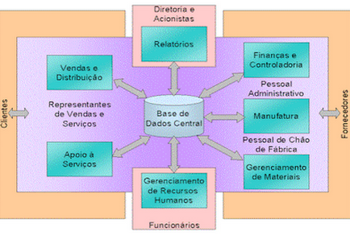
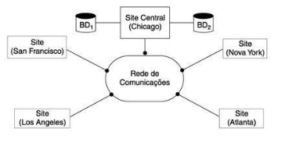
Banco de Dados – Vantagens
3-7 - Compartilhamento dos Dados
Permite a utilização simultânea e segura de um dado, por mais de uma aplicação ou usuário, independente da operação que esteja sendo realizada.

Slide 23
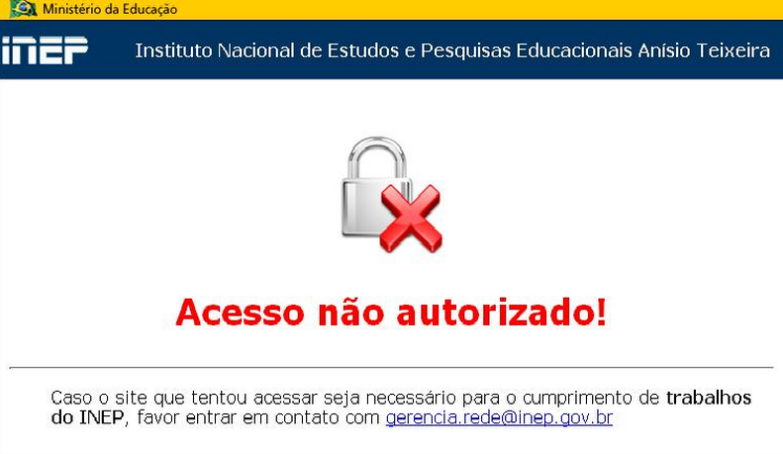
Banco de Dados – Vantagens
4-7 - Restrições de Segurança
- Define para cada usuário o nível de acesso a ele concedido (leitura, leitura e gravação ou sem acesso) ao arquivo e/ou campo.
- Este recurso impede que pessoas não autorizadas utilizem ou atualizem um determinado arquivo ou campo.

Slide 24
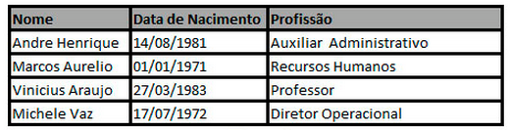
Banco de Dados – Vantagens
5-7 - Padronização dos Dados
Permite que os campos armazenados na base de dados sejam padronizados segundo um determinado formato de armazenamento.
Ex. Para o campo "Sexo" somente será permitido armazenamento dos conteúdos "M" ou "F".

Slide 25
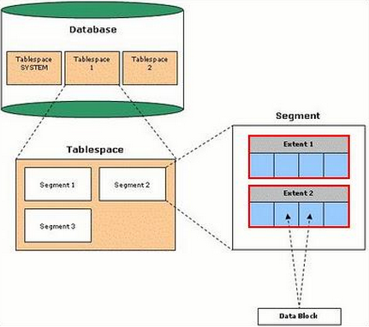
Banco de Dados – Vantagens
6-7 - Independência dos Dados
Representa a forma física de armazenamento dos dados no Banco de Dados e a recuperação das informações pelos programas de aplicação.
Esta recuperação deverá ser totalmente independente da maneira com que os dados estão fisicamente armazenados.
- Posso fazer mnt com o Banco de Dados Ativo.

Slide 26
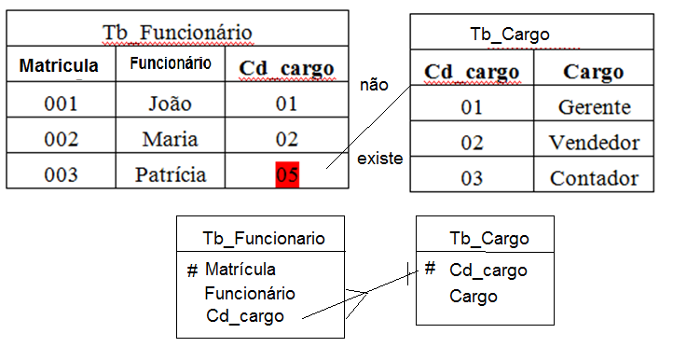
Banco de Dados – Vantagens
7-7 - Integridade referencial
- Consiste em impedir que um determinado código ou chave em uma tabela não tenha correspondência em outra tabela.

Slide 27
S.G.B.D. (Sistema Gerenciador de Banco de Dados)
Notes:
Large enterprise applications - the ones that execute core business applications, and keep a company going - must be more than just a bunch of code modules. They must be structured in a way that enables scalability, security, and robust execution under stressful conditions, and their structure - frequently referred to as their architecture - must be defined clearly enough that maintenance programmers can (quickly!) find and fix a bug that shows up long after the original authors have moved on to other projects. That is, these programs must be designed to work perfectly in many areas, and business functionality is not the only one (although it certainly is the essential core). Of course a well-designed architecture benefits any program, and not just the largest ones as we've singled out here. We mentioned large applications first because structure is a way of dealing with complexity, so the benefits of structure (and of modeling and design, as we'll demonstrate) compound as application size grows large. Another benefit of structure is that it enables code reuse: Design time is the easiest time to structure an application as a collection of self-contained modules or components. Eventually, enterprises build up a library of models of components, each one representing an implementation stored in a library of code modules. When another application needs the same functionality, the designer can quickly import its module from the library. At coding time, the developer can just as quickly import the code module into the application.

Slide 28

S.G.D.B. (Sistema Gerenciador de Banco de Dados)
- É o software responsável pelo gerenciamento (armazenamento e recuperação) dos dados no Banco de Dados.

Slide 29
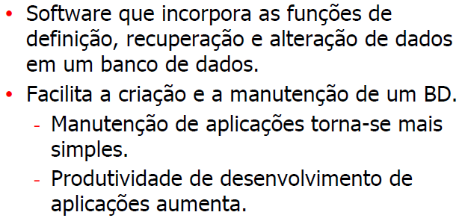
S.G.D.B. (Sistema Gerenciador de Banco de Dados)

Slide 30
Representação Física do SGBD
Notes:
Large enterprise applications - the ones that execute core business applications, and keep a company going - must be more than just a bunch of code modules. They must be structured in a way that enables scalability, security, and robust execution under stressful conditions, and their structure - frequently referred to as their architecture - must be defined clearly enough that maintenance programmers can (quickly!) find and fix a bug that shows up long after the original authors have moved on to other projects. That is, these programs must be designed to work perfectly in many areas, and business functionality is not the only one (although it certainly is the essential core). Of course a well-designed architecture benefits any program, and not just the largest ones as we've singled out here. We mentioned large applications first because structure is a way of dealing with complexity, so the benefits of structure (and of modeling and design, as we'll demonstrate) compound as application size grows large. Another benefit of structure is that it enables code reuse: Design time is the easiest time to structure an application as a collection of self-contained modules or components. Eventually, enterprises build up a library of models of components, each one representing an implementation stored in a library of code modules. When another application needs the same functionality, the designer can quickly import its module from the library. At coding time, the developer can just as quickly import the code module into the application.

Slide 31
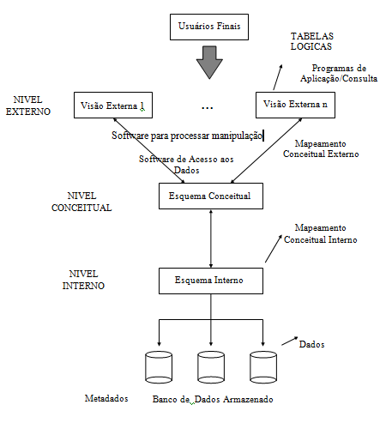
Representação Física do SGBD

Slide 32
SQL - Structured Query Language, ou Linguagem de Consulta Estruturada
Notes:
Large enterprise applications - the ones that execute core business applications, and keep a company going - must be more than just a bunch of code modules. They must be structured in a way that enables scalability, security, and robust execution under stressful conditions, and their structure - frequently referred to as their architecture - must be defined clearly enough that maintenance programmers can (quickly!) find and fix a bug that shows up long after the original authors have moved on to other projects. That is, these programs must be designed to work perfectly in many areas, and business functionality is not the only one (although it certainly is the essential core). Of course a well-designed architecture benefits any program, and not just the largest ones as we've singled out here. We mentioned large applications first because structure is a way of dealing with complexity, so the benefits of structure (and of modeling and design, as we'll demonstrate) compound as application size grows large. Another benefit of structure is that it enables code reuse: Design time is the easiest time to structure an application as a collection of self-contained modules or components. Eventually, enterprises build up a library of models of components, each one representing an implementation stored in a library of code modules. When another application needs the same functionality, the designer can quickly import its module from the library. At coding time, the developer can just as quickly import the code module into the application.

Slide 33

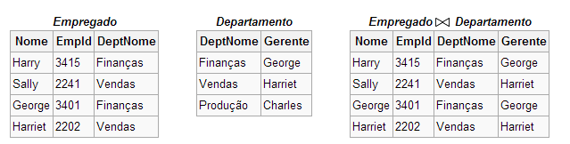
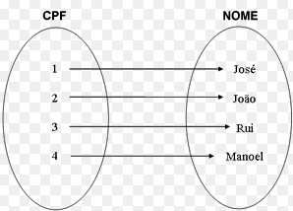
SQL - Structured Query Language
Surgiu dos trabalhos teóricos de Edgard F. Codd (IBM) procurando um modelo lógico independente de detalhes de implementação.
Teoria dos conjuntos
Baseado na álgebra relacional.

Slide 34
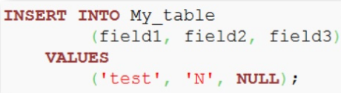
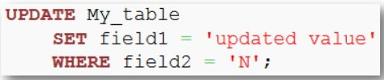
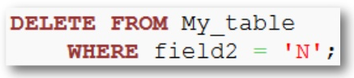
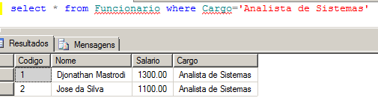
Banco de dados Relacional
Esta tarefa foi realizada pela American National Standards Institute (ANSI) em 1986 e ISO em 1987.
O SQL foi revisto em 1992 e a esta versão foi dado o nome de SQL-92. Foi revisto novamente em 1999 e 2003 para se tornar SQL:1999 (SQL3) e SQL:2003, respectivamente.

Slide 35
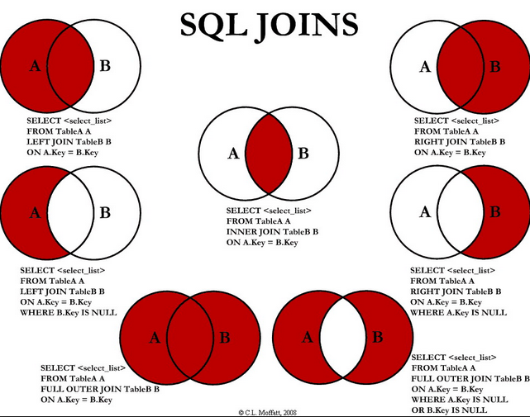
SQL - Structured Query Language
Teoria dos conjuntos

Slide 36
SGBD - Regras
Notes:
Large enterprise applications - the ones that execute core business applications, and keep a company going - must be more than just a bunch of code modules. They must be structured in a way that enables scalability, security, and robust execution under stressful conditions, and their structure - frequently referred to as their architecture - must be defined clearly enough that maintenance programmers can (quickly!) find and fix a bug that shows up long after the original authors have moved on to other projects. That is, these programs must be designed to work perfectly in many areas, and business functionality is not the only one (although it certainly is the essential core). Of course a well-designed architecture benefits any program, and not just the largest ones as we've singled out here. We mentioned large applications first because structure is a way of dealing with complexity, so the benefits of structure (and of modeling and design, as we'll demonstrate) compound as application size grows large. Another benefit of structure is that it enables code reuse: Design time is the easiest time to structure an application as a collection of self-contained modules or components. Eventually, enterprises build up a library of models of components, each one representing an implementation stored in a library of code modules. When another application needs the same functionality, the designer can quickly import its module from the library. At coding time, the developer can just as quickly import the code module into the application.

Slide 37
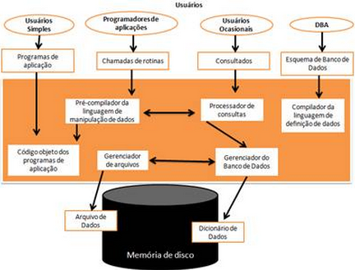
SGBD - Regras
Regra 1: Auto-Contenção
Um SGBD não contém apenas os dados em si, mas armazena completamente toda a descrição dos dados, seus relacionamentos e formas de acesso. Normalmente esta regra é chamada de Meta-Base de Dados.

Slide 38
SGBD - Regras
Regra 1: Auto-Contenção

Slide 39
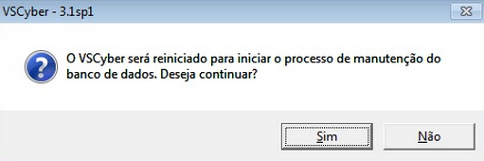
SGBD - Regras
Regra 2: Independência dos Dados
Quando as aplicações estiverem realmente imunes a mudanças na estrutura de armazenamento ou na estratégia de acesso aos dados, podemos dizer que esta regra foi atingida.

Slide 40
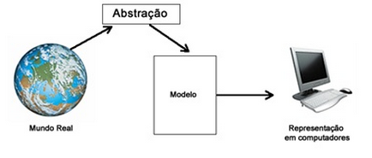
SGBD - Regras
Regra 3: Abstração dos Dados
- Em um SGBD real é fornecida ao usuário somente uma representação conceitual dos dados, o que não inclui maiores detalhes sobre sua forma de armazenamento real.
- O chamado Modelo de Dados é um tipo de abstração utilizada para fornecer esta representação conceitual.

Slide 41

SGBD - Regras
Regra 4: Visões
- Um SGBD deve permitir que cada usuário visualize os dados de forma diferente daquela existente previamente no Banco de Dados.
- Uma visão consiste de um subconjunto de dados do Banco de Dados, necessariamente derivados dos existentes no Banco de Dados, porém estes não deverão estar explicitamente armazenados.
.

Slide 42
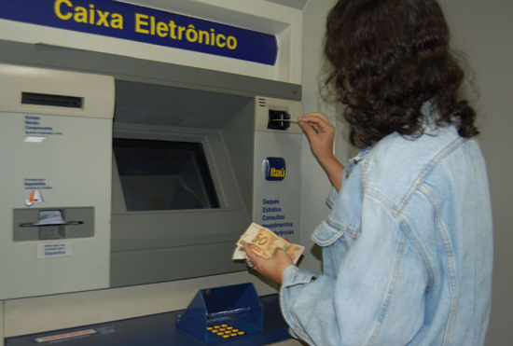
SGBD - Regras
Regra 5: Transações
- Desta forma exige-se que o banco de dados tenha ao menos uma instrução que permita a gravação de uma série modificações simultâneas e uma instrução capaz de cancelar um série modificações.

Slide 43
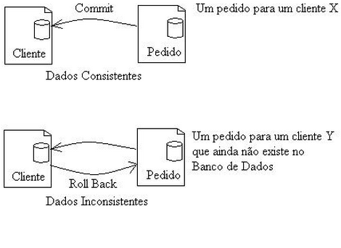
SGBD - Regras
Regra 5: Transações
- Desta forma exige-se que o banco de dados tenha ao menos uma instrução que permita a gravação de uma série modificações simultâneas e uma instrução capaz de cancelar um série modificações.

Slide 44
SGBD - Regras
Regra 6: Integridade referencial
-Um SGBD deve gerenciar completamente a integridade referencial definida em seu esquema, sem precisar em tempo algum, do auxílio do programa aplicativo.

Slide 45

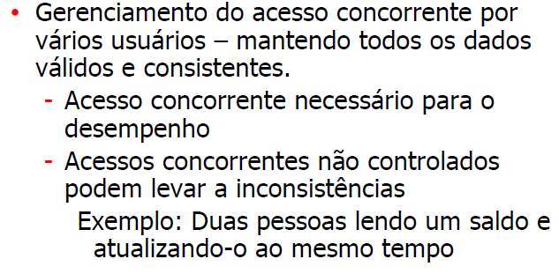
SGBD - Regras
Regra 7: Acesso Automático

Slide 46

Administradores de Banco de Dados (DBA)
-São responsáveis pelo controle ao acesso aos dados e pela coordenação da utilização do BD.
Responsável por autorizar o acesso, coordenar e monitorar sua utilização, adquirir recursos de hardware e software quando necessário, avaliar desempenho e problemas de segurança do sistema.
- É a pessoa que fornece o suporte técnico necessário para implementar essas decisões.

Slide 47
Questionário
‹#›

Slide 48

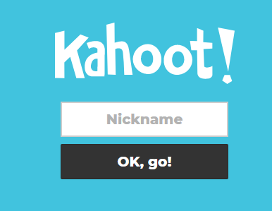
Questionário
Nome + RA
‹#›

Slide 49
Objetivo
Conceitos Básicos
Banco de Dados
Banco de Dados – Vantagens
S.G.B.D. (Sistema Gerenciador de Banco de Dados)
Representação Física do SGBD
SQL - Structured Query Language, ou Linguagem de Consulta Estruturada
SGBD – Regras
Administradores de Banco de Dados (DBA)
Questionário
‹#›

